Slide 1
APOLOGETICS
IN ONE LESSON
almost
Ai1L.net
Lesson 21
Regarding Miracles

Slide 2
Key Takeaways (review)
1
Showing people that they should want the Gospel to be true is important
2
The Gospel helps us to make sense of this world
3
We have desires that cannot be filled with things in this world

Slide 3
IDEA IN BRIEF
What?
Be able to show that miracles are not irrational
Why?
So that we can offer help others that find a belief in miracles difficult
How?
By showing that arguments against miracles are often caused by presuppositions or different definitions

Slide 4
What do you think is a good definition of a miracle?
1

Slide 5
One definition of a miracle
1
Brought about by the power of God
2
Temporary
3
Exception
4
To the ordinary course of nature
5
For the purpose of showing that God has acted in history

Slide 6
What are some barriers that may cause people to struggle to accept miracles?
2

Slide 7
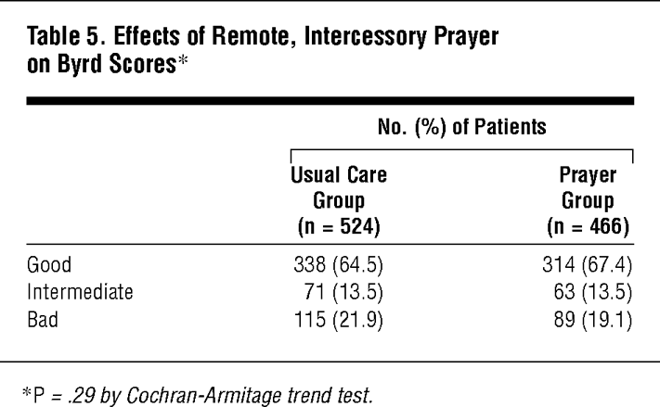
 | Usual care | Prayer group
 | 524 people | 466 people
Good | 64.5% | 67.4% | Increase
Intermediate | 13.5% | 13.5% | No change
Bad | 21.9% | 19.1% | Decrease

Slide 8
Effects of Prayer on Heart Patients¹
 | Usual care | Prayer group
 | 524 people | 466 people
MAHI-CCU score² (lower is better) | 7.13 | 6.35 | 11% improvement
Unweighted MAHI-CCU score³ (lower is better) | 3.00 | 2.70 | 10% improvement
¹ | From table 4 in “A Randomized, Controlled Trial of the Effects of Remote, Intercessory Prayer on Outcomes in Patients Admitted to the Coronary Care Unit”
² | Stands for “Mid America Heart Institute–Cardiac Care Unit ”
³ | Unweighted means a simple count of the events per patient

Slide 9
To what degree does “extraordinary claims require extraordinary evidence”?
3

Slide 10
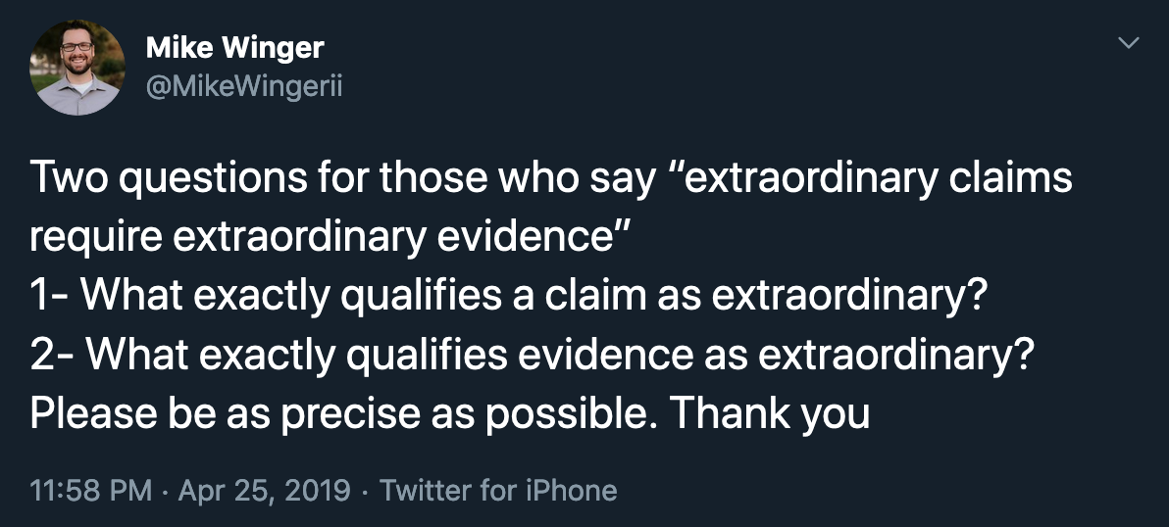
http://bit.ly/Ai1LExtraordinary

Slide 11
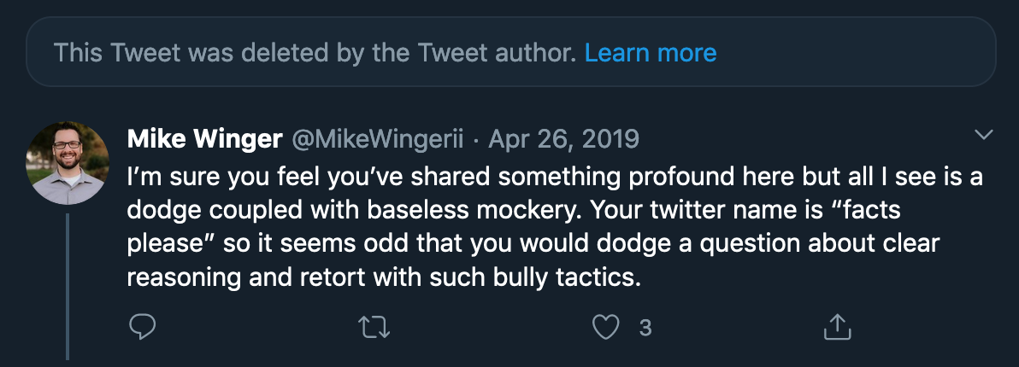
Response 1

Slide 12
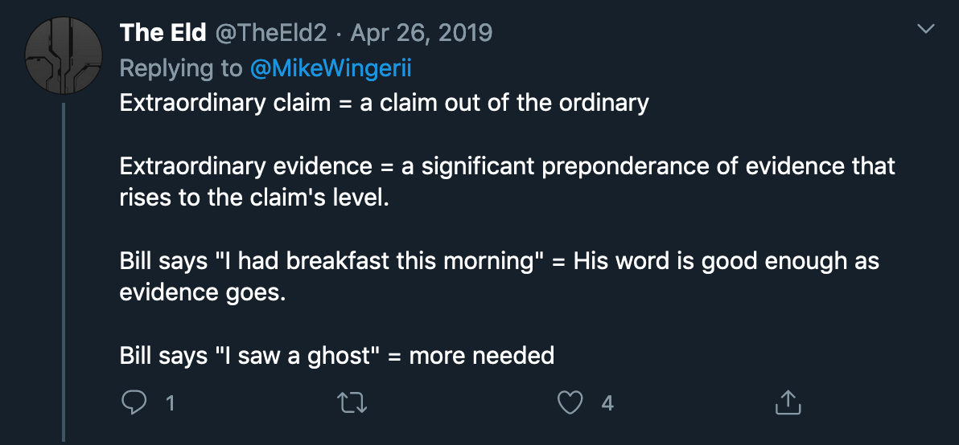
Response 2

Slide 13
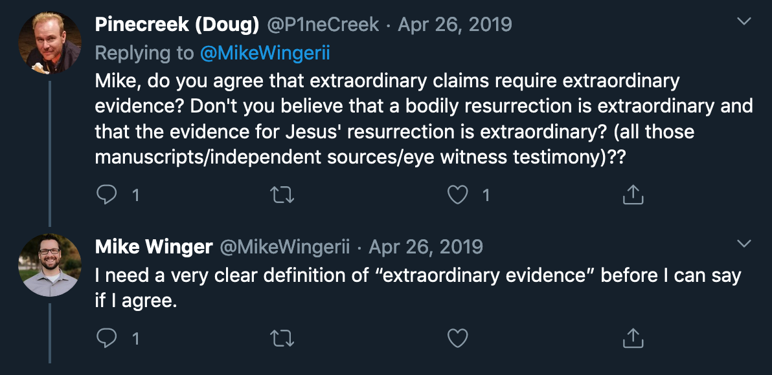
Response 3

Slide 14
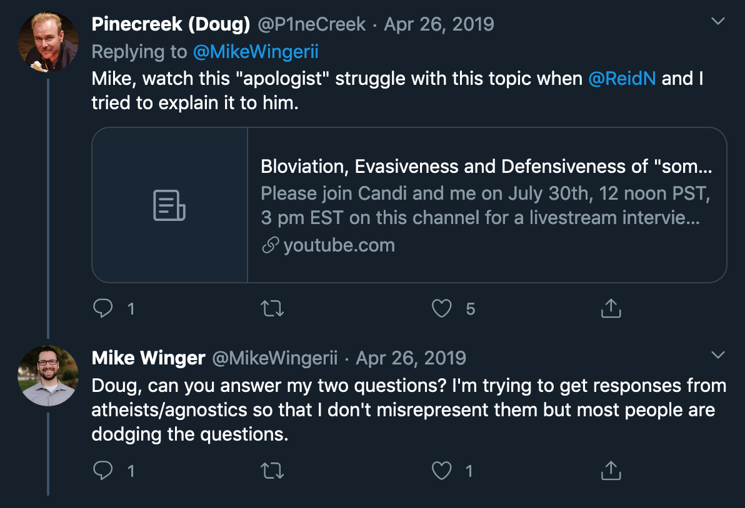
Response 4

Slide 15
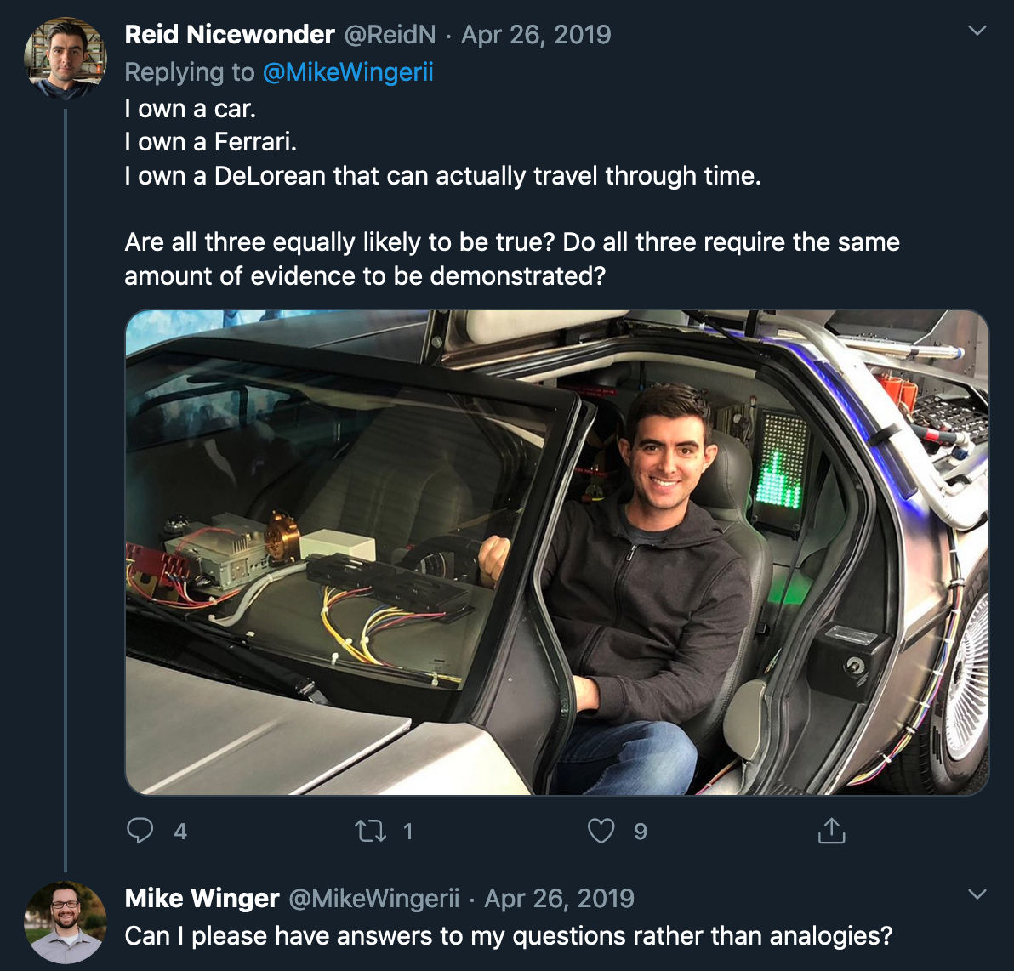
Response 5

Slide 16
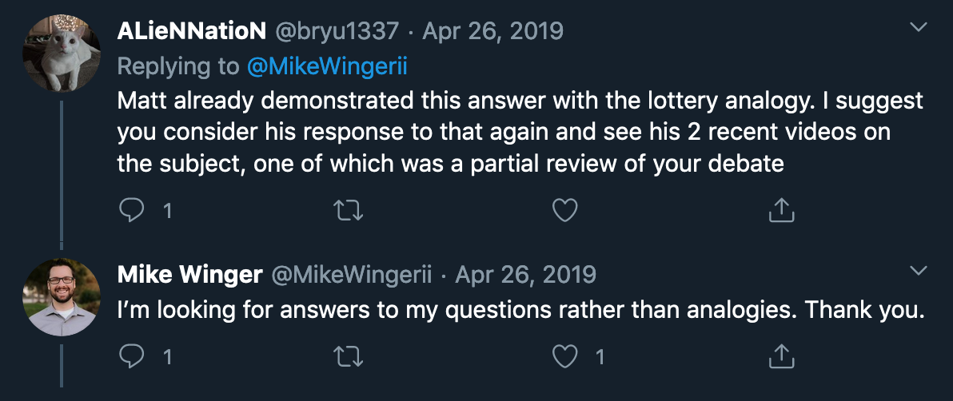
Response 6

Slide 17
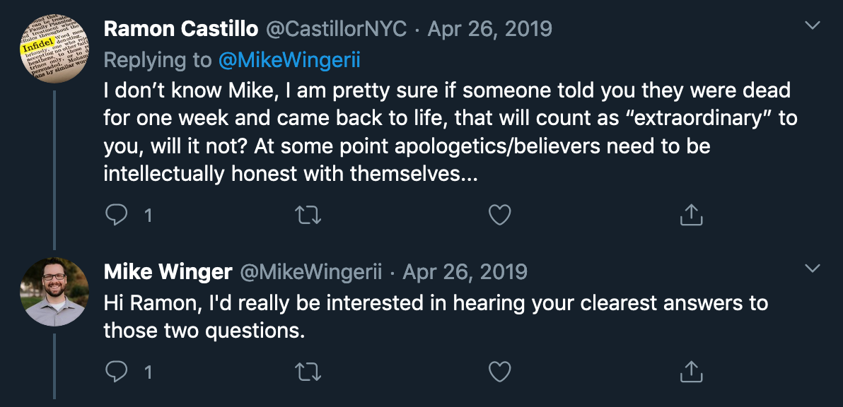
Response 7

Slide 18
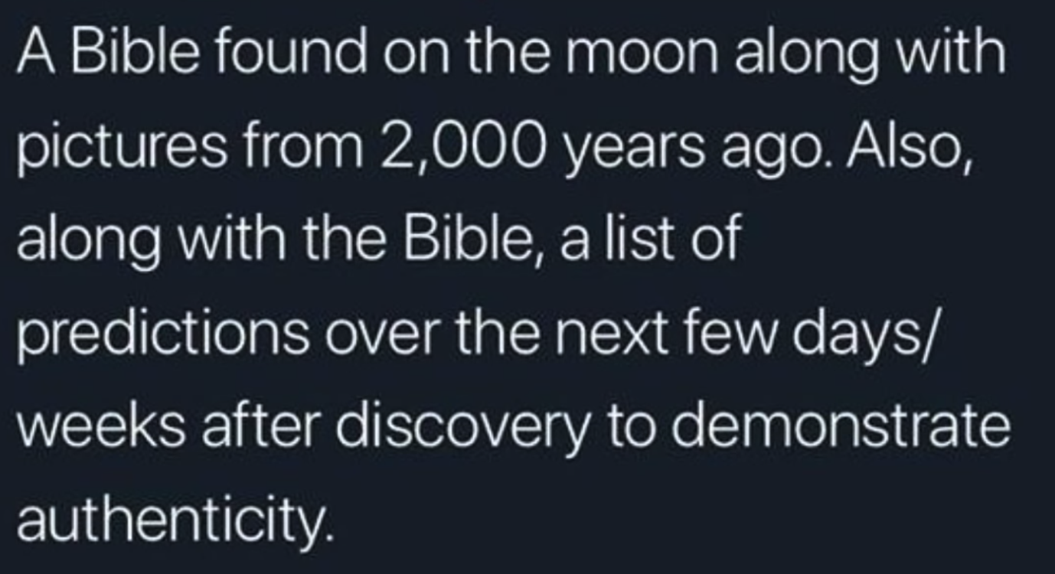
Extraordinary evidence 1

Slide 19
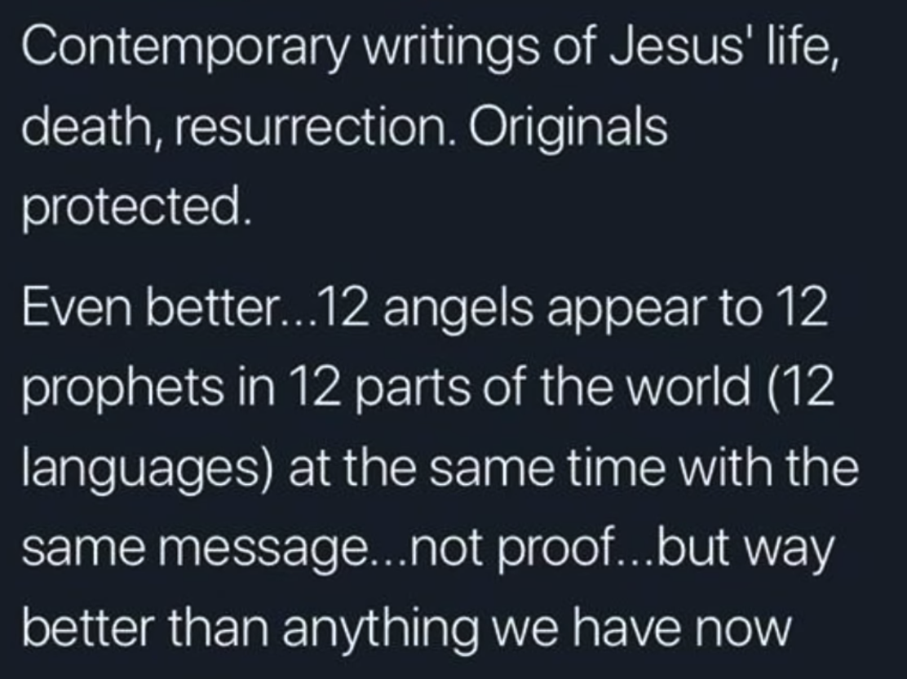
Extraordinary evidence 2

Slide 20
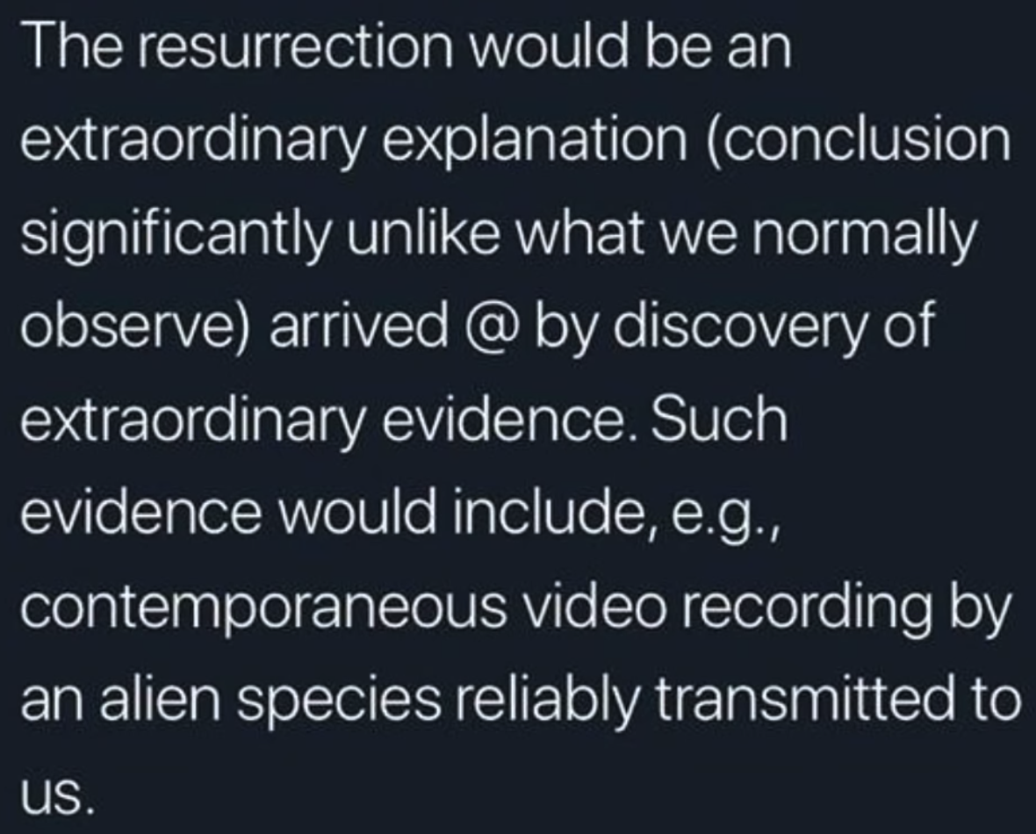
Extraordinary evidence 3

Slide 21
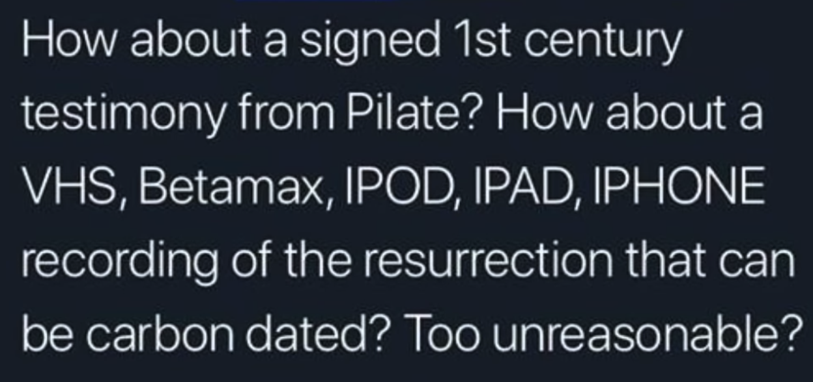
Extraordinary evidence 4

Slide 22
What are some considerations and thoughts that may be useful for defending miracles?
4

Slide 23
Key Takeaways
1
Make sure you know how others define “miracle”
2
Focus on Jesus’ resurrection: it is the miracle that we have the strongest evidence for
3
Recognize that presuppositions and worldviews are likely the main cause of resistance to a belief in miracles

